Slide 1
GraphQL and React
Jason Monroe - 688776

Slide 2
App Feature / Scenario
In our DevBios app, we would like add a complex search feature to analyze and report on our Developers. We would like to filter live data from a server on every field How can this be achieved?

Slide 3
Course Objective:
At the end this 120 min session, you will be able to
Describe GraphQL features
Write GraphQL Queries
Implement GraphQL Query searches in a React App

Slide 4
Benefits
GraphQL is an efficient and popular query language that is widely used
Optimizes RESTful calls
Clients are implementing GraphQL

Slide 5
Key Topics
GraphQL Overview
Querying GraphQL
Mutations in GraphQL
Implementing in React

Slide 6
GraphQL Overview

Slide 7

Developed at Facebook to mitigate the problems of inadequate networks handling increased usage on inadequate mobile hardware

Slide 8
Query control delegated to client side
Front end requests exactly what it needs
No need to create additional server side endpoints
Retrieve only data the front end needs in a single request

Slide 9
GraphQL Architectures
Backing Database
https://www.tutorialspoint.com/graphql/graphql_architecture.htm

Slide 10
GraphQL Architectures
Integrated systems
https://www.tutorialspoint.com/graphql/graphql_architecture.htm

Slide 11
GraphQL Architectures
Hybrid
https://www.tutorialspoint.com/graphql/graphql_architecture.htm

Slide 12
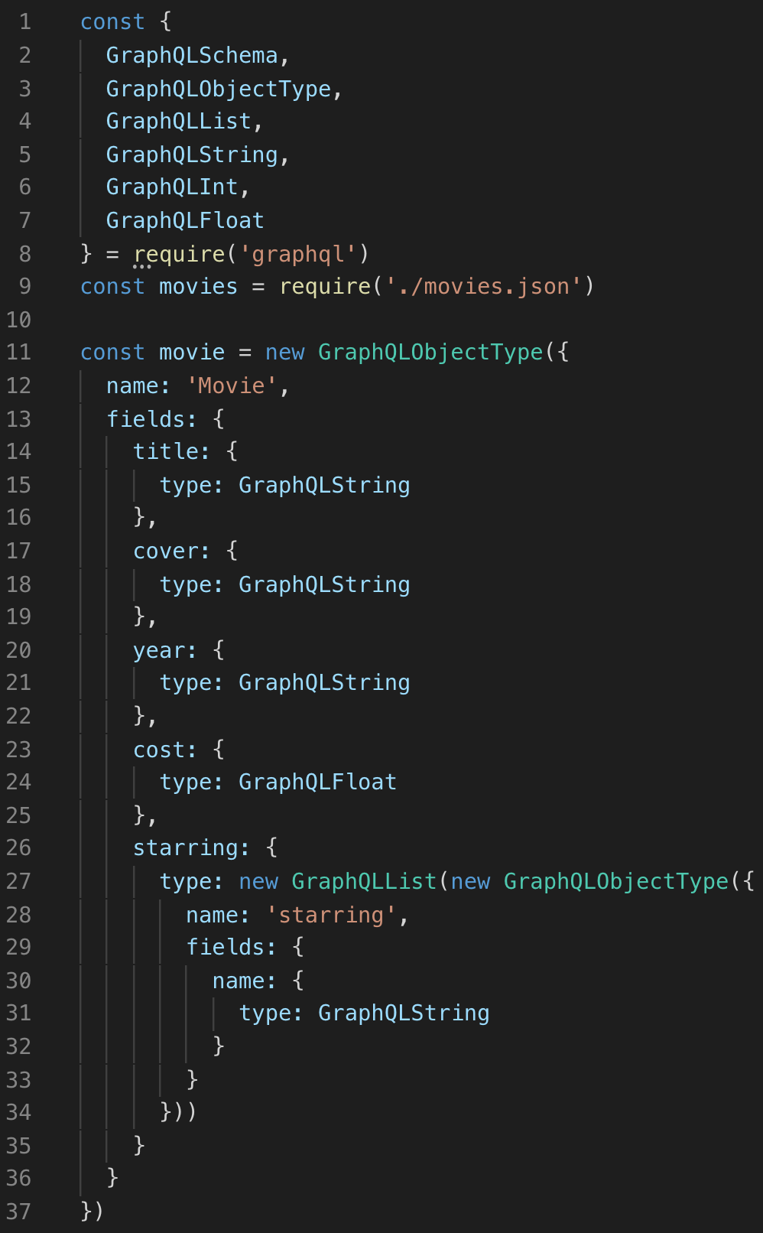
Schema
Schema.js file in GraphQL server determines strongly typed data models and the supported queries

Slide 13
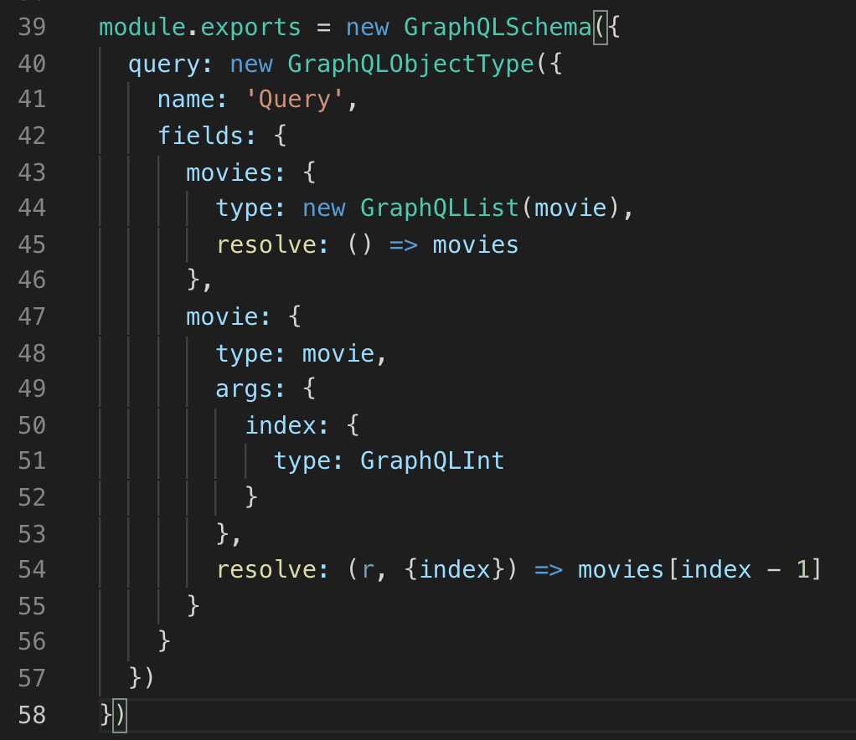
Schema
Two queries are defined here
”movies” which returns all movies
“movie” which accepts an index argument and returns the movie with the corresponding index.
Every query starts with a property that indicates its name, what type of data it returns, optional arguments , a resolve property that defines a resolver function

Slide 14
GraphQL Queries

Slide 15
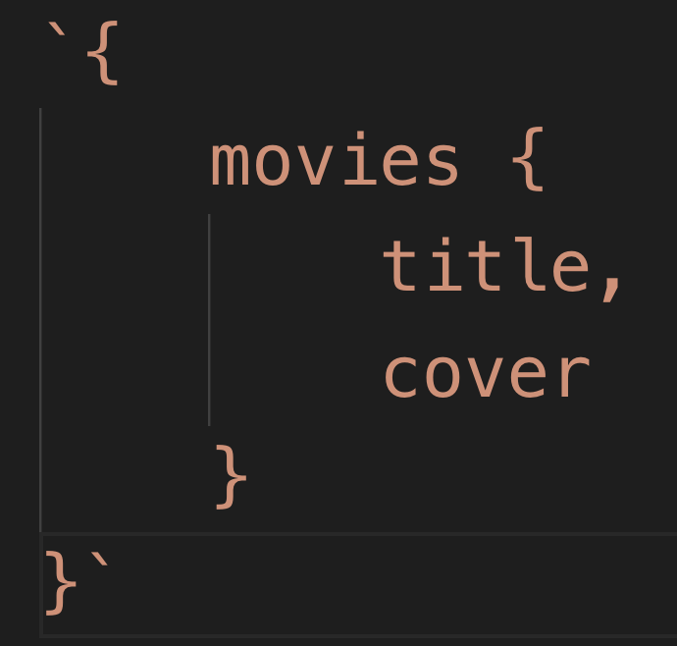
Querying Server
Query name that matches query in Schema.js on server
GraphQL Query is sent as a JSON-esque syntax with the query name in front of { } which contain the desired fields
Fields to return

Slide 16
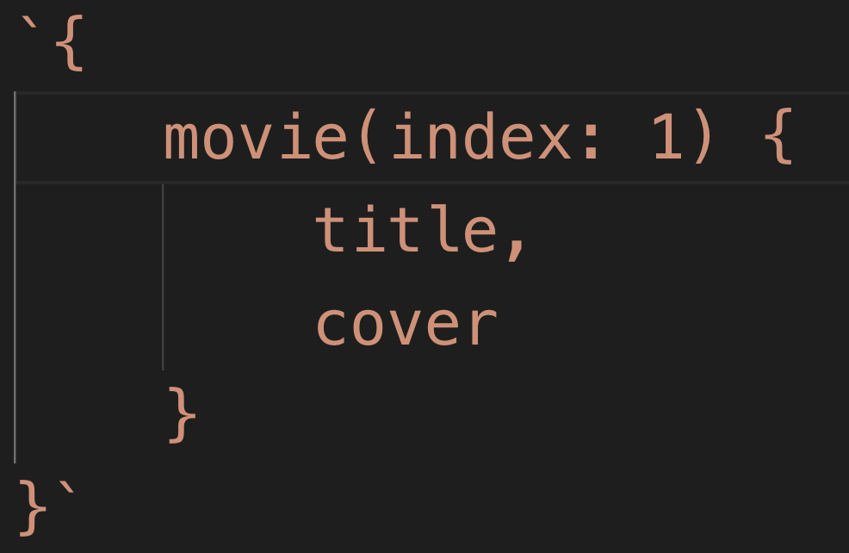
Querying Server
Index argument on movie query
Queries that take arguments are written with the arguments passed in parenthesis as a key : value pairs

Slide 17

Code Along Practice – Hit Live API for Developers
Using this endpoint: https://movies-graphql.cfapps.io/q?query=
Query all movies, showing title and year. The query name is ”movies”
Query the movie with index 2. The query name is “movie”
Query all movies starring Johnny Depp. The query name is “starring”

Slide 18
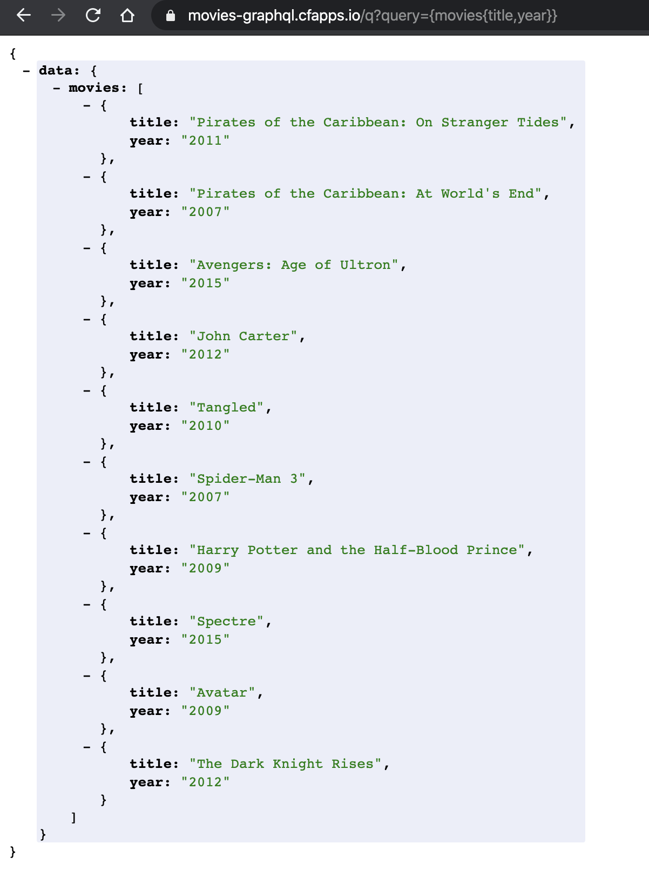
#1

Slide 19
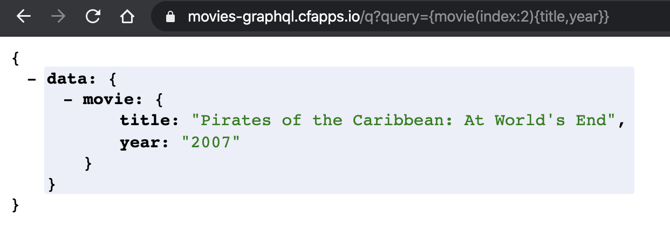
#2

Slide 20
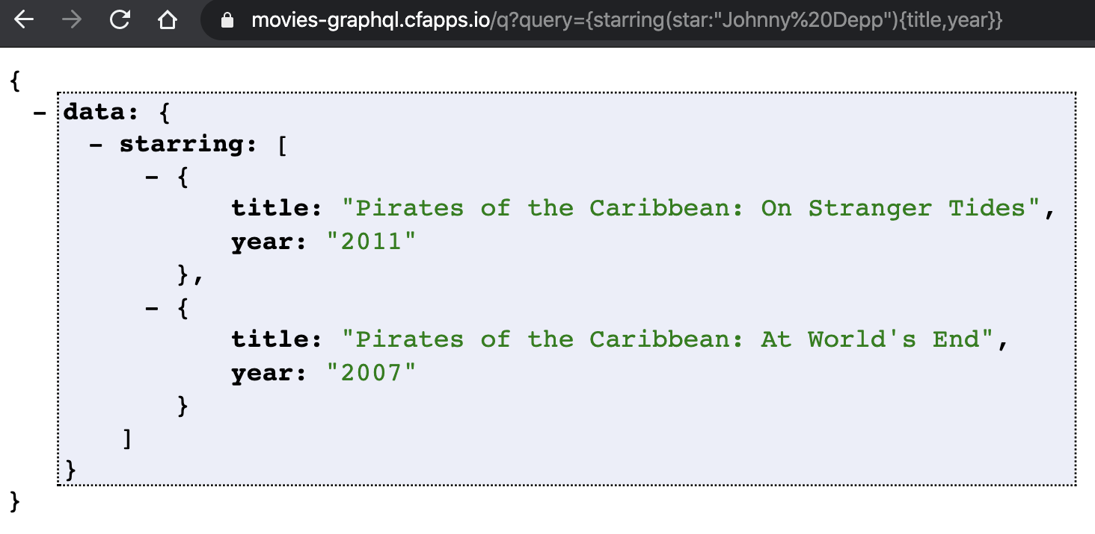
#3

Slide 21
GraphQL Mutations

Slide 22
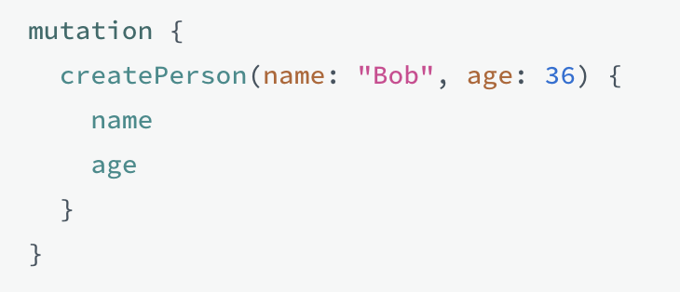
Mutations
GraphQL Mutations add data to the database, much like a traditional post / insert.

Slide 23
GraphQL in React

Slide 24
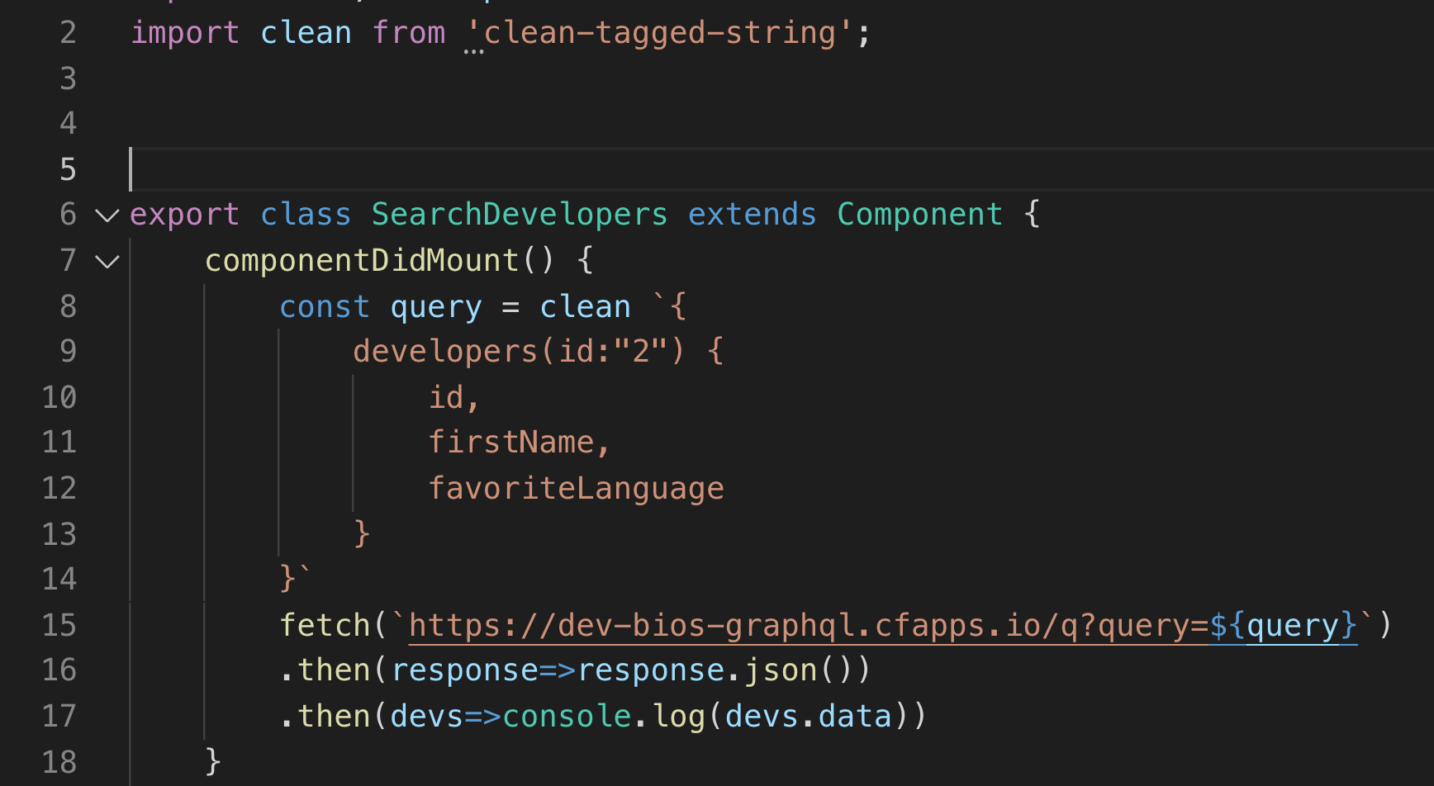
From React
Write query as multiline string
Use ‘clean-tagged-string’ library to remove line returns
Make GET request with .fetch()

Slide 25
Code Along Practice – GraphQL Search
Create SearchDevelopers.js file
Allow user to search by any one criteria
Build query and fetch results
Display results

Slide 26
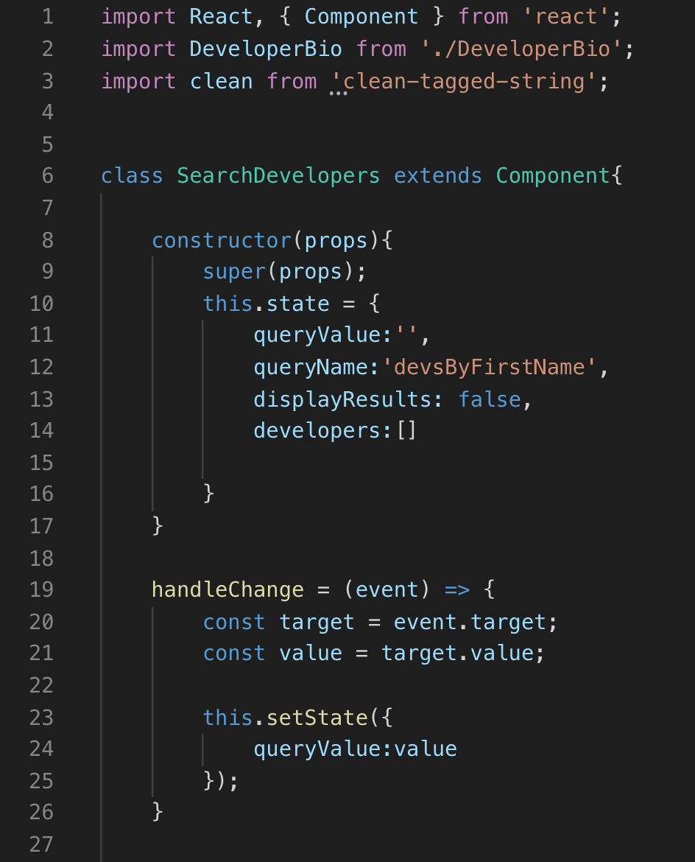

Slide 27
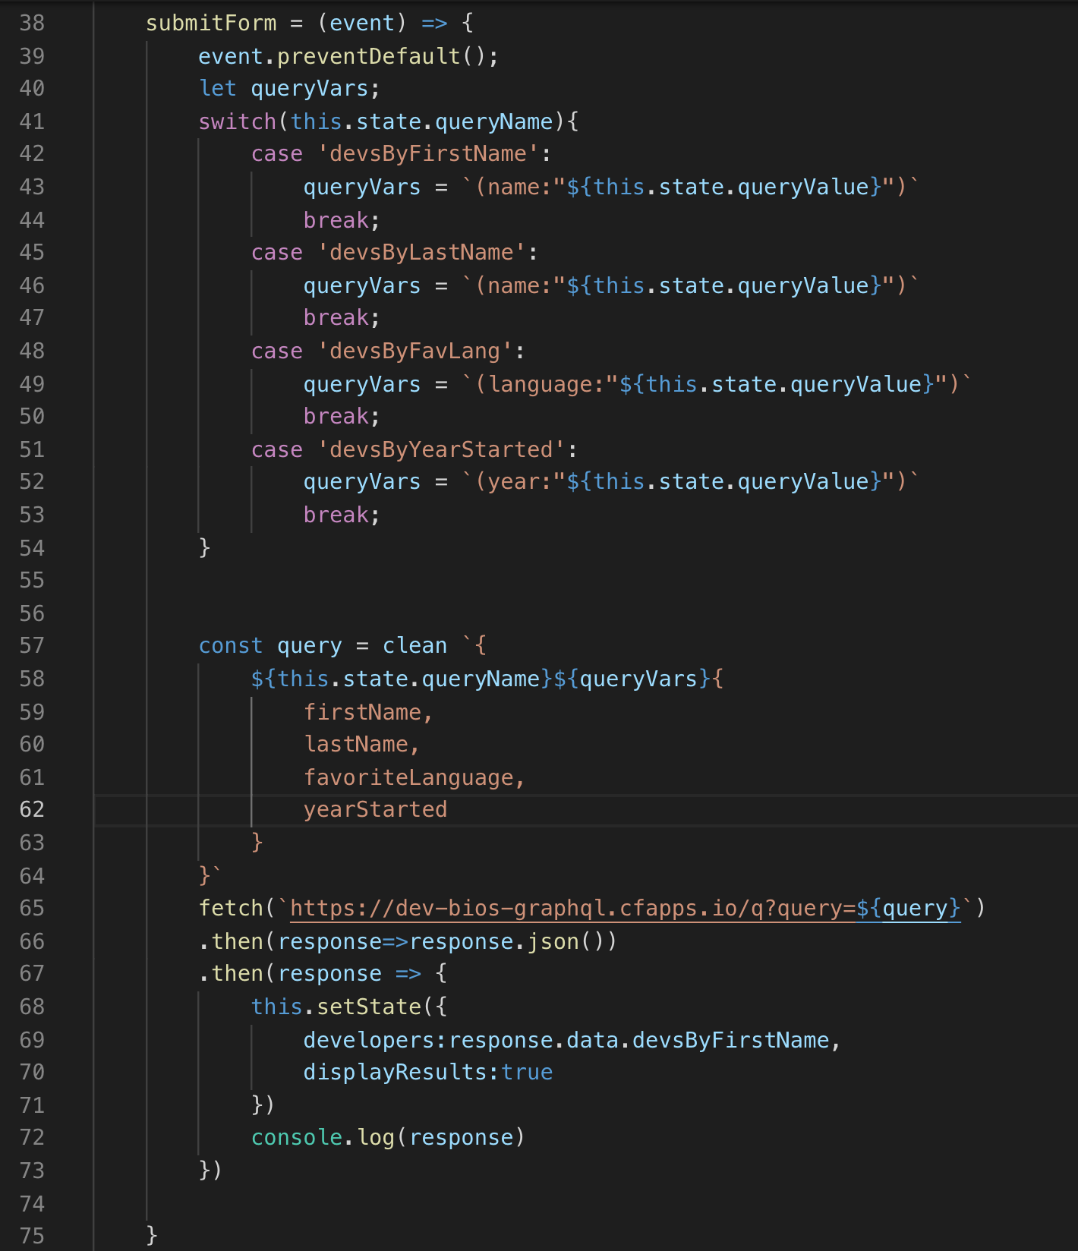
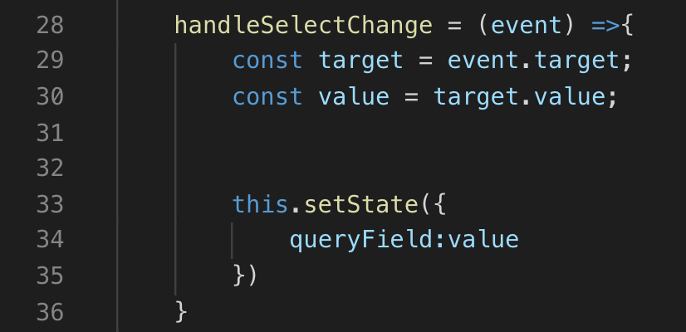

Slide 28
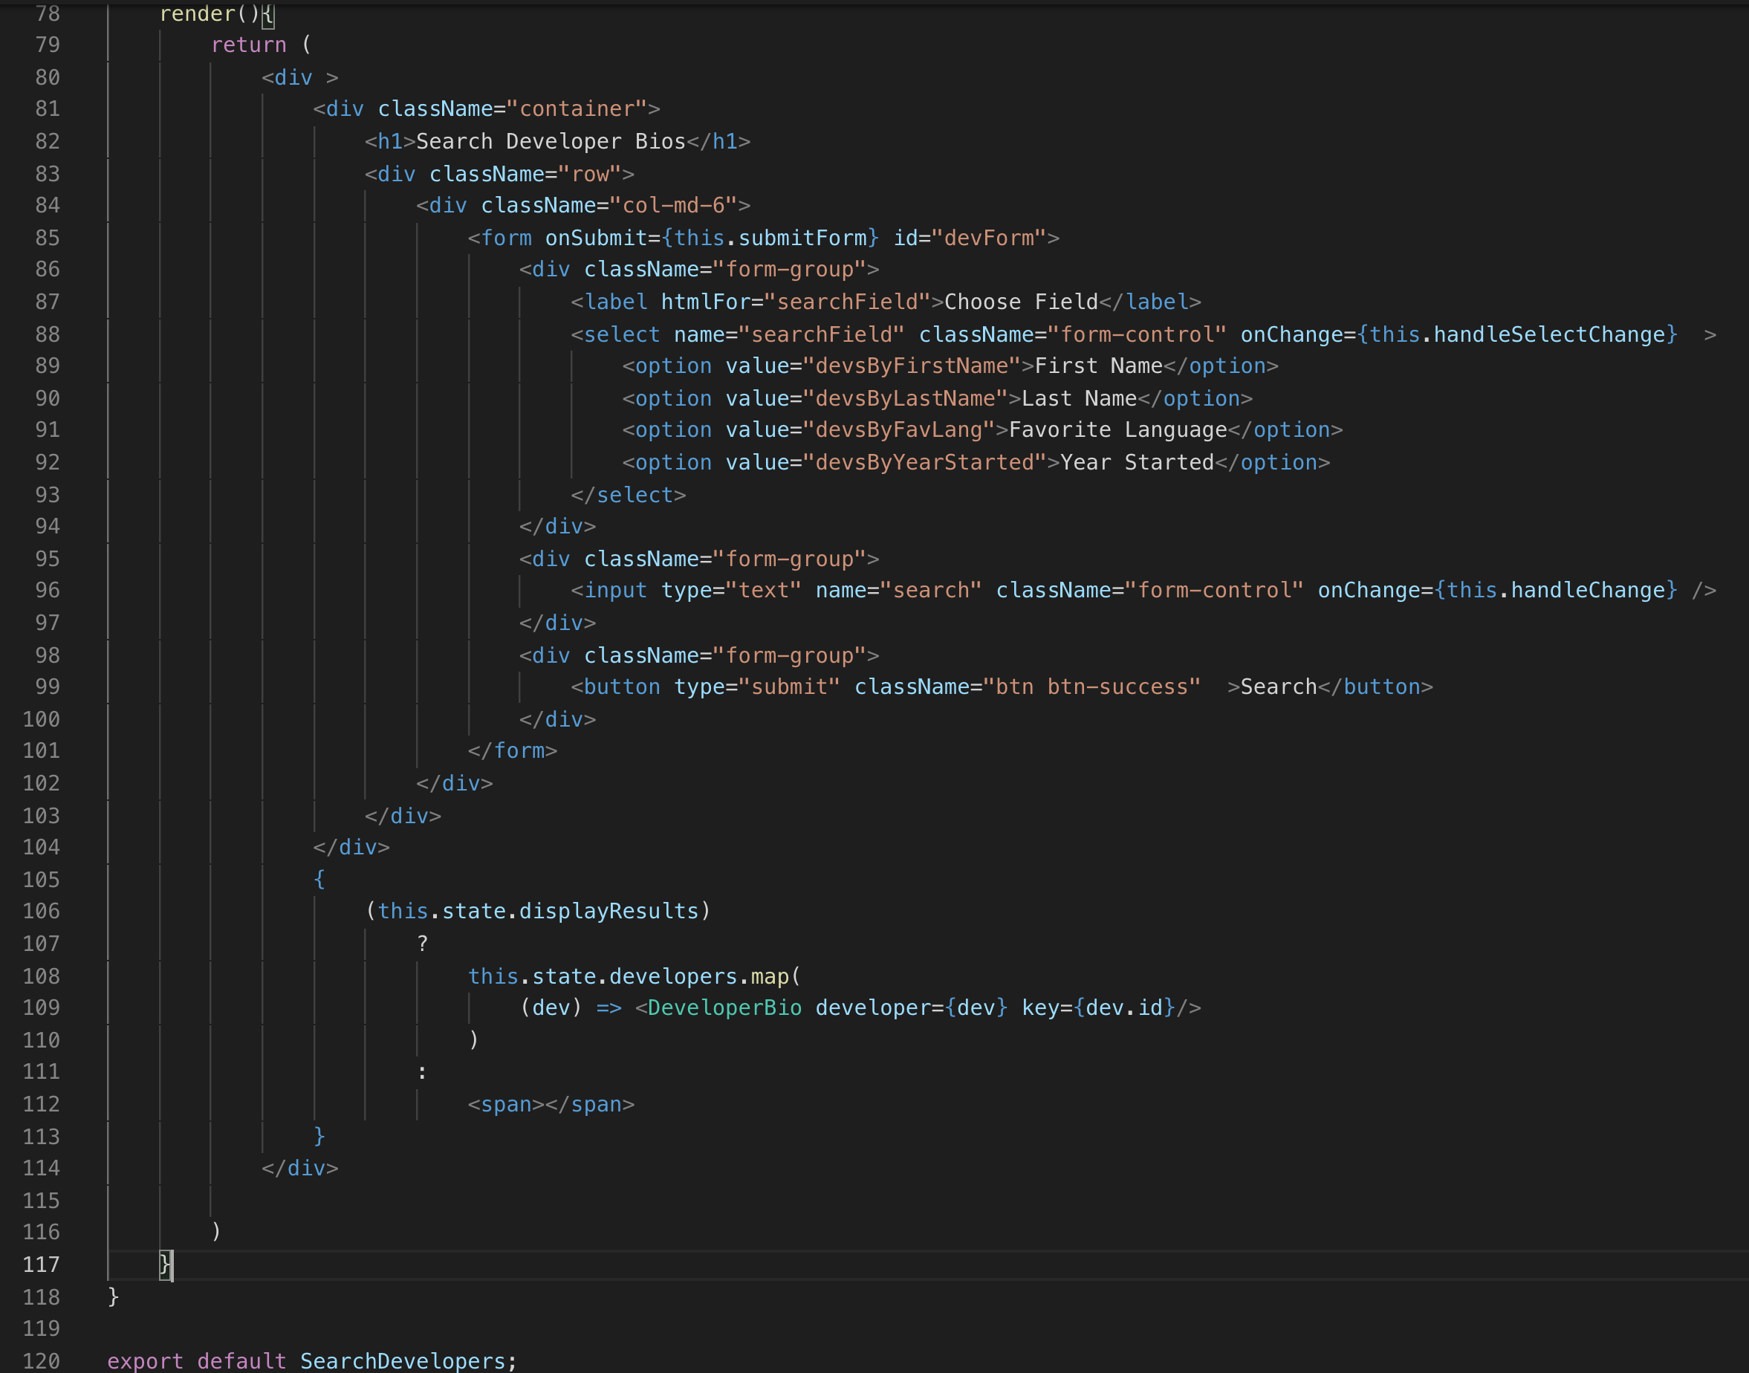

Slide 29
Review
GraphQL overview
Schemas
Queries
Implementation

Slide 30
Course Objective:
At the end this 120 min session, you will be able to
Describe GraphQL features
Write GraphQL Queries
Implement GraphQL Query searches in a React App

Slide 31
What are the advantages of GraphQL?
What are its limitations?

Slide 32
Thank You

